Slide 1
Lesson 10
Attitude Determination & Control System (ADCS)
Notes:
https://www.youtube.com/watch?v=jVXgWGK9Kr8

Slide 2
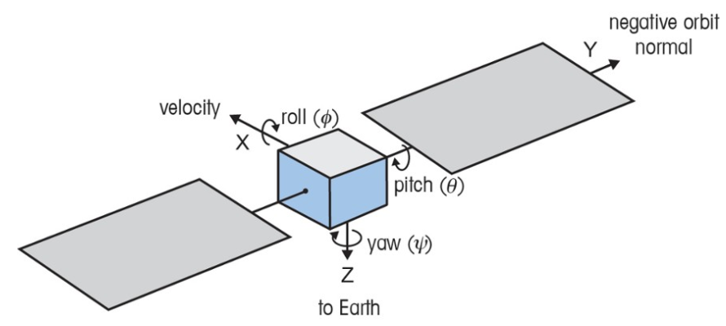
Definition: Spacecraft Attitude
The orientation of a spacecraft in space.
→ Which way it’s pointing
More specifically: the angular relationship between the spacecraft’s body frame (axes fixed to the spacecraft) and a reference frame (often an inertial frame).
Spacecraft Body Frame

Slide 3
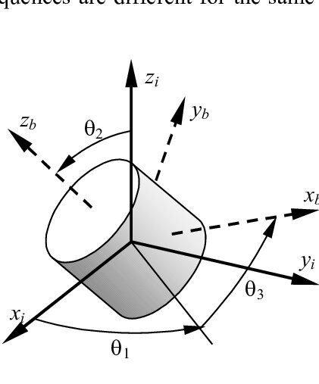
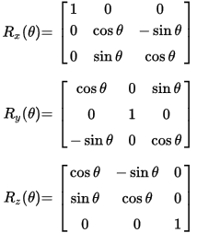
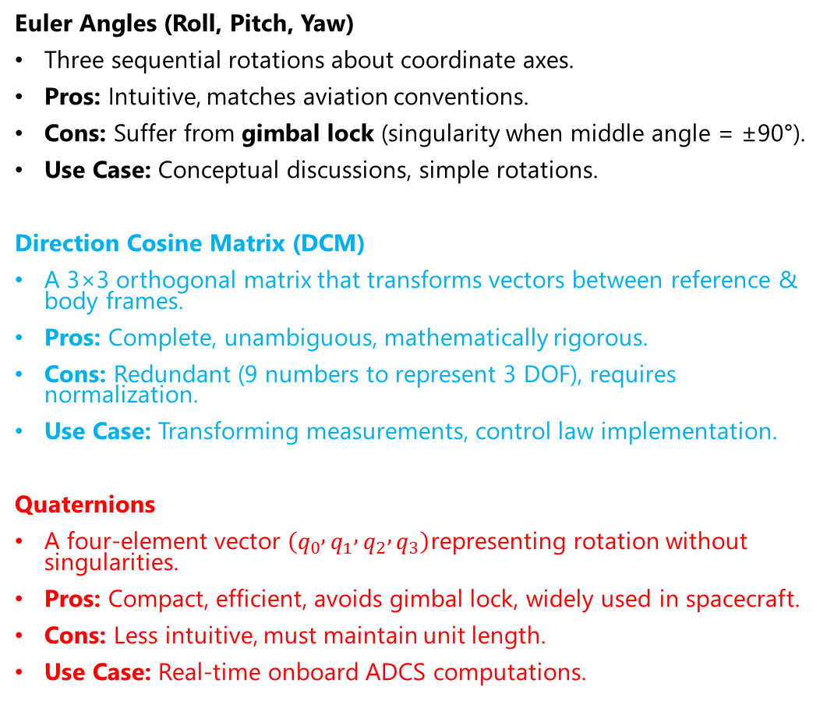
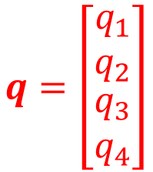
Common Attitude Parametrizations
Euler Angles (Roll, Pitch, Yaw)
Three sequential rotations about coordinate axes.
Pros: Intuitive, matches aviation conventions.
Cons: Suffer from gimbal lock (singularity when middle angle = ±90°).
Use Case: Conceptual discussions, simple rotations.
Direction Cosine Matrix (DCM)
A 3×3 orthogonal matrix that transforms vectors between reference & body frames.
Pros: Complete, unambiguous, mathematically rigorous.
Cons: Redundant (9 numbers to represent 3 DOF), requires normalization.
Use Case: Transforming measurements, control law implementation.
Quaternions
A four-element vector $\left(q_{0} , q_{1} , q_{2} , q_{3}\right)$representing rotation without singularities.
Pros: Compact, efficient, avoids gimbal lock, widely used in spacecraft.
Cons: Less intuitive, must maintain unit length.
Use Case: Real-time onboard ADCS computations.
$$q=\left[\begin{matrix}q_{1} \\ q_{2} \\ \begin{aligned}q_{3} \\ q_{4}\end{aligned}\end{matrix}\right]$$

Slide 4
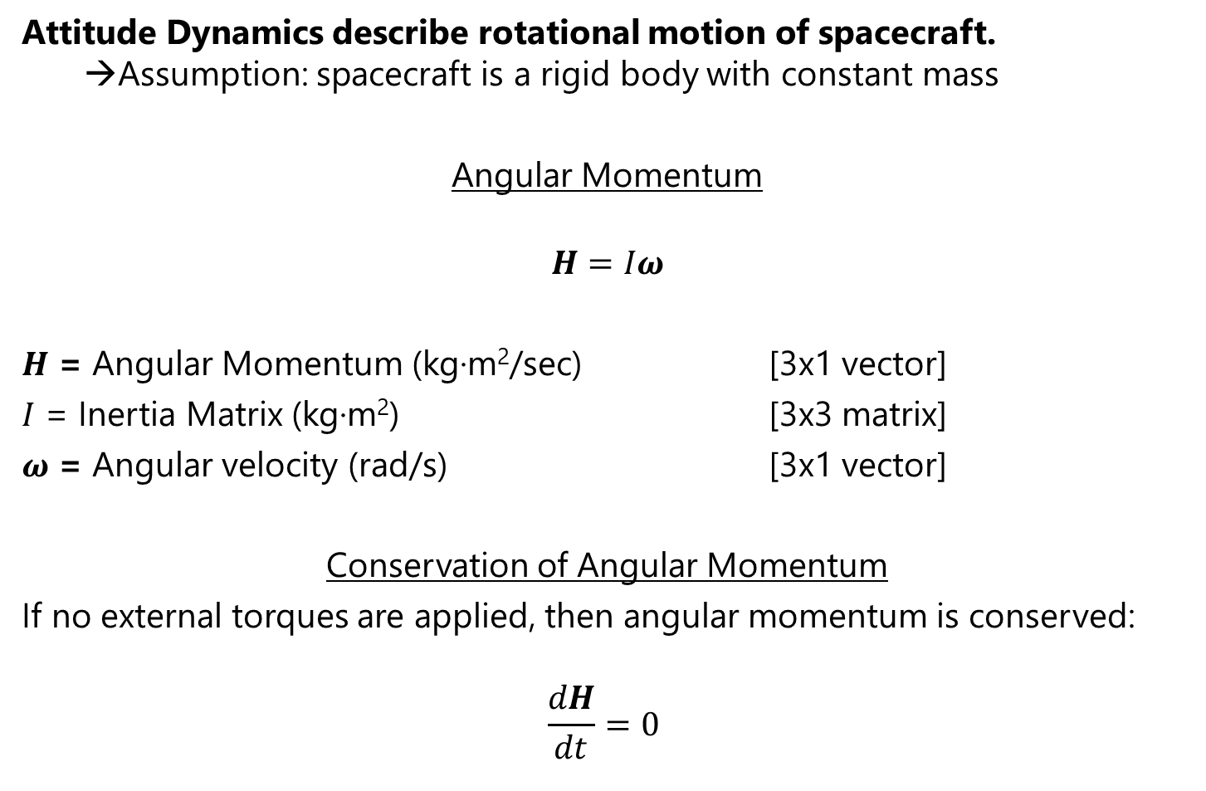
Attitude Dynamics Fundamentals
Attitude Dynamics describe rotational motion of spacecraft.
→Assumption: spacecraft is a rigid body with constant mass
Angular Momentum
$$H=Iω$$
$H$ = Angular Momentum (kg·m²/sec) [3x1 vector]
$I$ = Inertia Matrix (kg·m²) [3x3 matrix]
$ω$ = Angular velocity (rad/s) [3x1 vector]
Conservation of Angular Momentum
If no external torques are applied, then angular momentum is conserved:
$$\frac{dH}{dt}=0$$
Notes:
If no external torque acts ($T_{\text{ext}}=0$):
Angular momentum is conserved.
A spacecraft will keep spinning at the same rate and orientation (principle of gyroscopic motion).
If external torques do act (gravity gradient, solar pressure, thrusters, magnetic torquers):
They change the spacecraft’s angular momentum.
This is the basis of attitude control — actuators apply torques to adjust orientation.

Slide 5
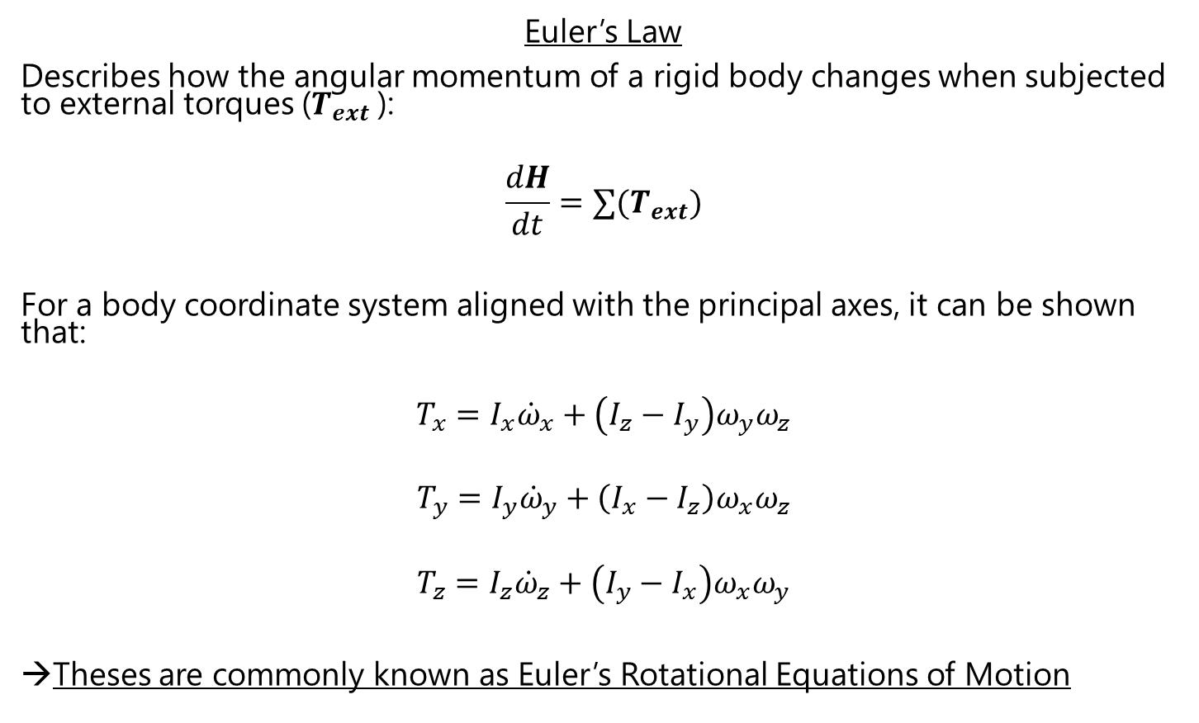
Attitude Dynamics Fundamentals (2)
Euler’s Law
Describes how the angular momentum of a rigid body changes when subjected to external torques ($T_{ext}$):
$$\frac{dH}{dt}=∑(T_{ext})$$
For a body coordinate system aligned with the principal axes, it can be shown that:
$$T_{x}=I_{x}{\dot{ω}}_{x}+\left(I_{z}−I_{y}\right)ω_{y}ω_{z}$$
$$T_{y}=I_{y}{\dot{ω}}_{y}+\left(I_{x}−I_{z}\right)ω_{x}ω_{z}$$
$$T_{z}=I_{z}{\dot{ω}}_{z}+\left(I_{y}−I_{x}\right)ω_{x}ω_{y}$$
→Theses are commonly known as Euler’s Rotational Equations of Motion
Notes:
First order ODE
Coupled
Nonlinear
Nonhomogeneous (if T not equal 0)
The cross-coupling terms $\left(I_{y}−I_{z}\right)ω_{y}ω_{z}$etc. show that rotation about one axis affects the others unless the spacecraft is perfectly symmetric. This explains why asymmetric satellites can tumble unpredictably if not controlled.

Slide 6
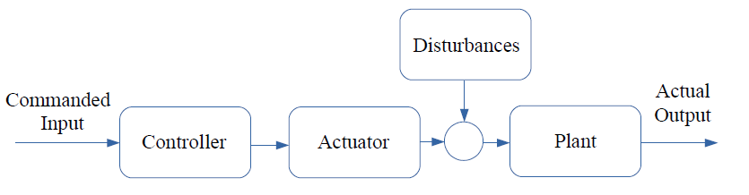
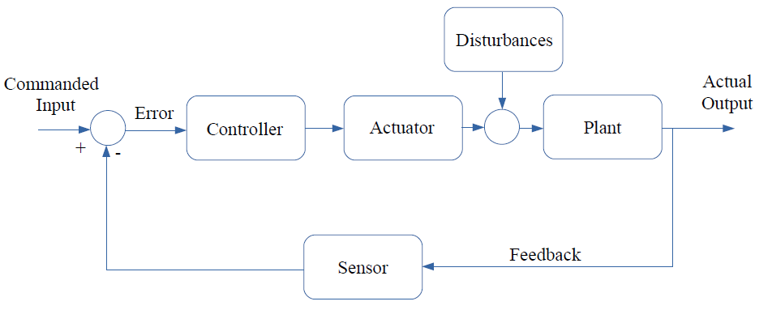
Control Systems
Open Loop Control:
Closed Loop Control:

Slide 7
Guidance, Navigation & Control (GNC)
Guidance: Generates desired trajectory for spacecraft to follow.
Navigation: Estimates current spacecraft state using sensors.
Control: Generates actuator commands needed to achieve guidance trajectory using navigation estimate.
Control
Guidance
Navigation

Slide 8
Attitude Determination & Control Subsystem (ADCS)
The Attitude Determination and Control Subsystem (ADCS) ensures a spacecraft points in the right direction and remains stable while performing its mission.
Attitude Determination: figuring out which way the spacecraft is pointing.
Uses sensors to measure orientation relative to Earth, Sun, stars, or inertial space.
Attitude Control: changing or maintaining pointing direction.
Uses actuators to apply torques and correct orientation or reduce rotation.
ADCS must overcome internal & external disturbance torques!

Slide 9
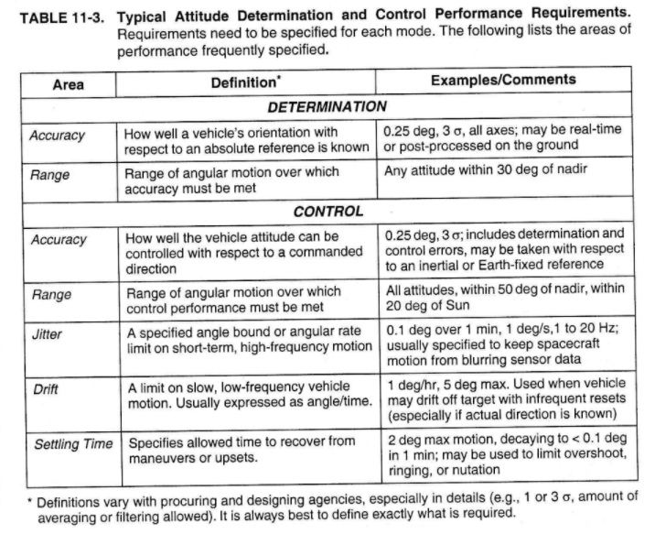
ADCS: Performance Requirements

Slide 10
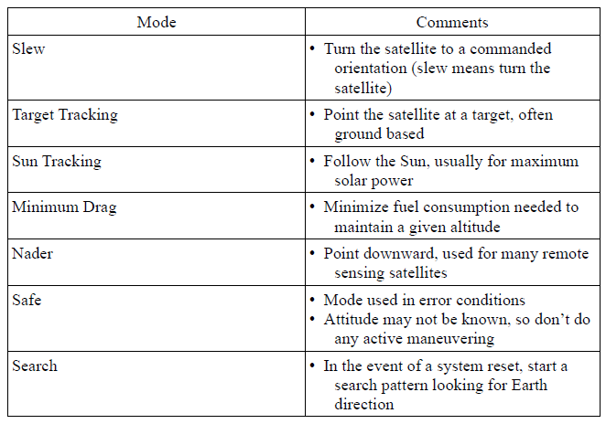
Tracking Modes

Slide 11
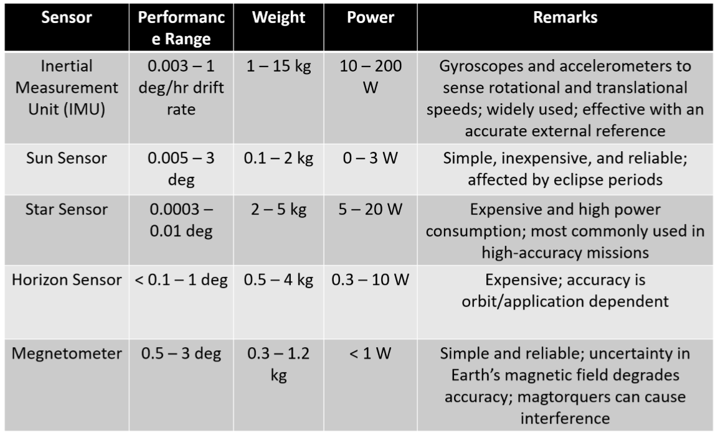
ADCS: Sensors

Slide 12
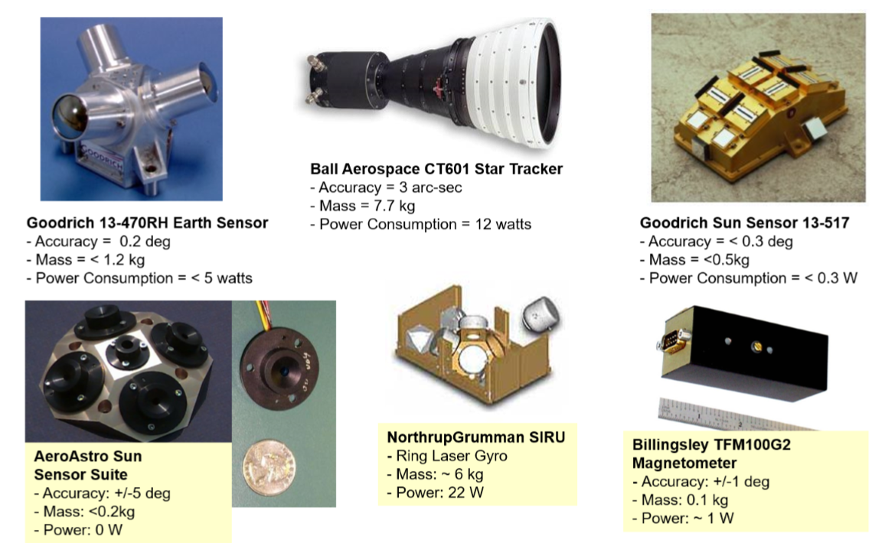
ADCS: Sensors (2)

Slide 13
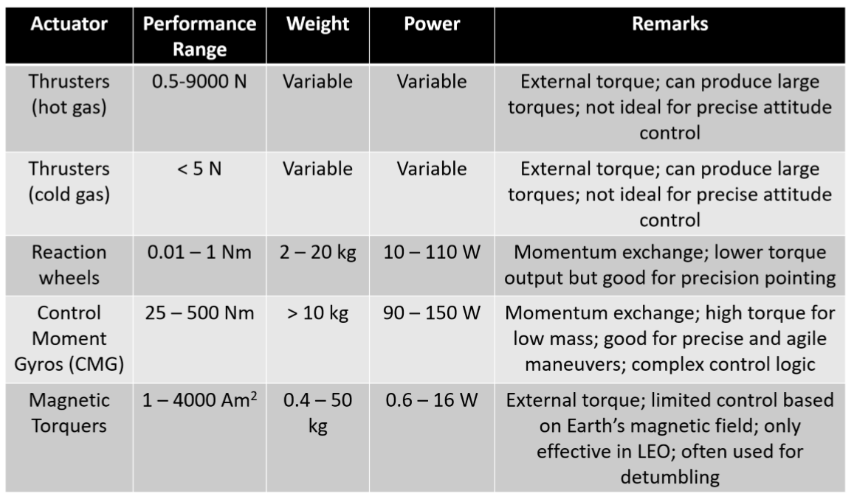
ADCS: Actuators

Slide 14
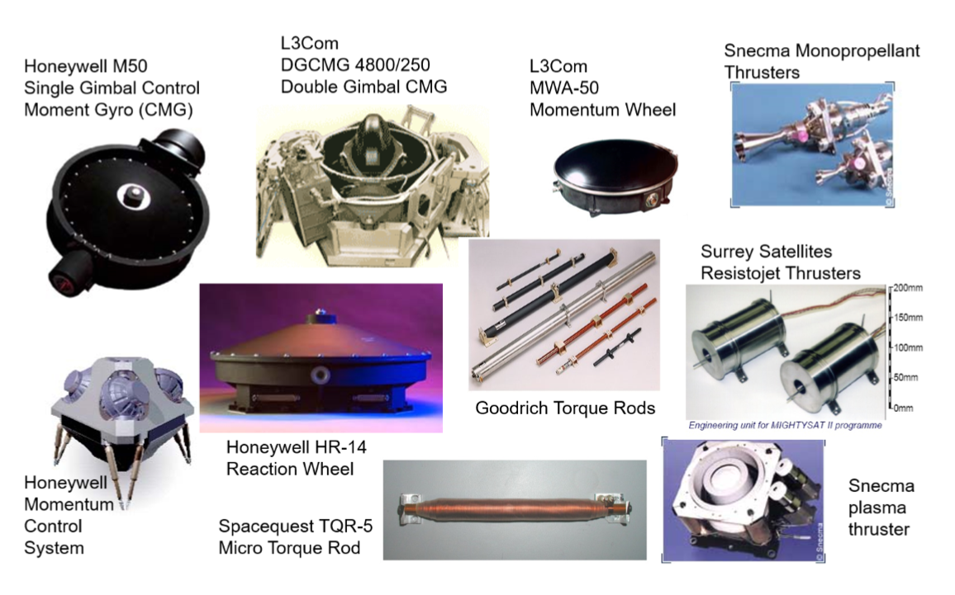
ADCS: Actuators (2)

Slide 15
External Attitude Disturbance Torques
Gravity Gradient
Magnetic
Solar Radiation Pressure (SRP)
Atmospheric Drag
Notes:
Gravity Gradient Torque
Caused by Earth’s non-uniform gravity field acting on different parts of the spacecraft.
Stronger in low Earth orbit (LEO).
Tends to align the spacecraft’s long axis with Earth’s center.
Magnetic Torque
Interaction between the spacecraft’s residual magnetic dipole and Earth’s magnetic field.
Especially important for small satellites with electronics that retain magnetization.
Can be both a disturbance and a control method (using magnetorquers).
Solar Radiation Pressure (SRP) Torque
Generated by photons from the Sun imparting momentum on spacecraft surfaces.
Stronger for satellites with large solar arrays or asymmetric shapes.
Can cause slow attitude drift or jitter.
Atmospheric Drag Torque
Occurs in low Earth orbit due to residual atmosphere.
Drag force acts at the center of pressure, which may not align with the spacecraft’s center of mass → torque.
Significant for large, flat-panel spacecraft or CubeSats in LEO.

Slide 16
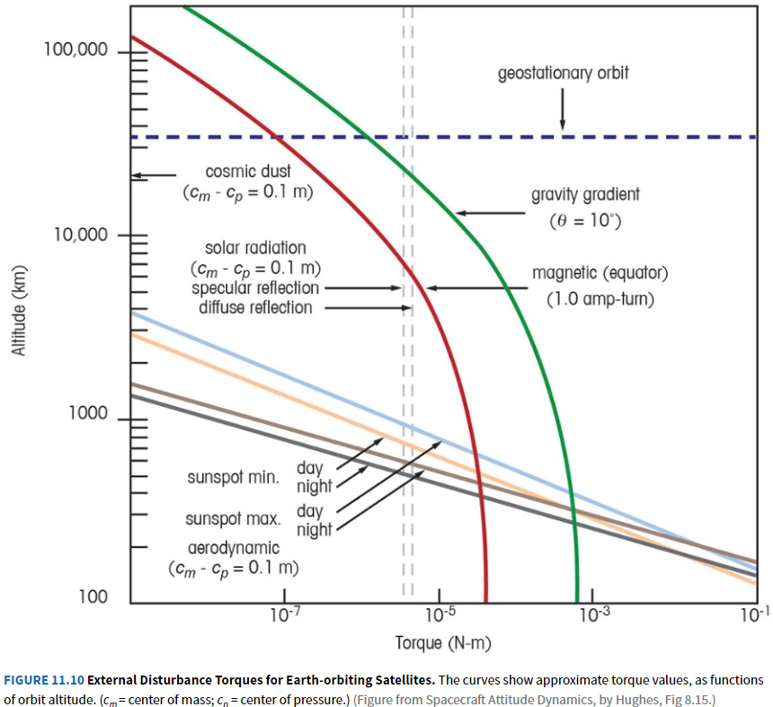
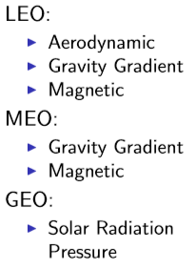
External Attitude Disturbance Torques (2)
Dominant disturbances

Slide 17
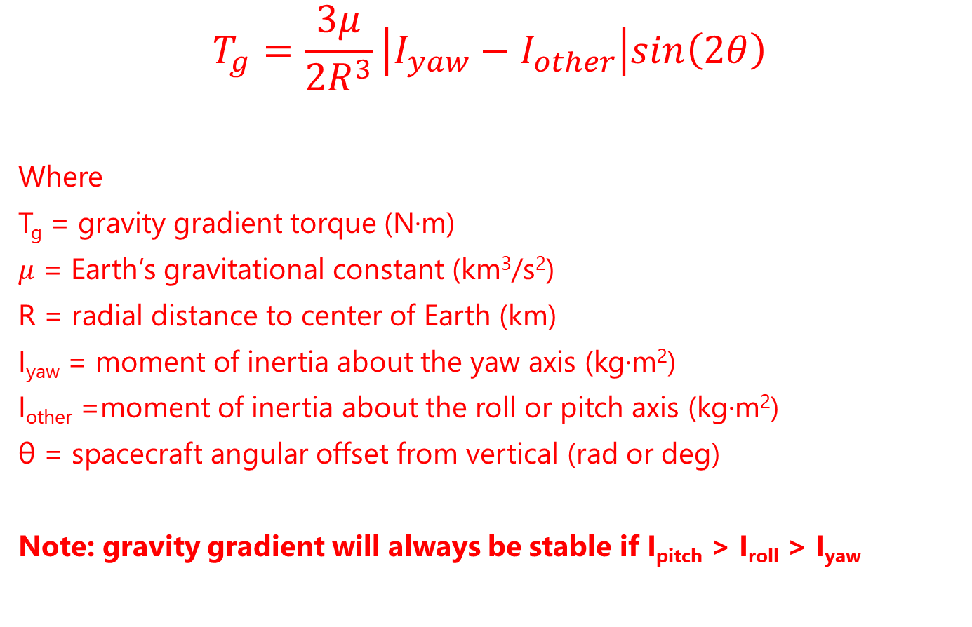
External Disturbance Torques – Gravity Gradient
$$T_{g}=\frac{3μ}{2R^{3}}\left|I_{yaw}−I_{other}\right|sin\left(2θ\right)$$
Where
T_{g} = gravity gradient torque (N·m)
$μ$ = Earth’s gravitational constant (km³/s²)
R = radial distance to center of Earth (km)
I_{yaw} = moment of inertia about the yaw axis (kg·m²)
I_{other} =moment of inertia about the roll or pitch axis (kg·m²)
θ = spacecraft angular offset from vertical (rad or deg)
Note: gravity gradient will always be stable if I_{pitch} > I_{roll} > I_{yaw}

Slide 18
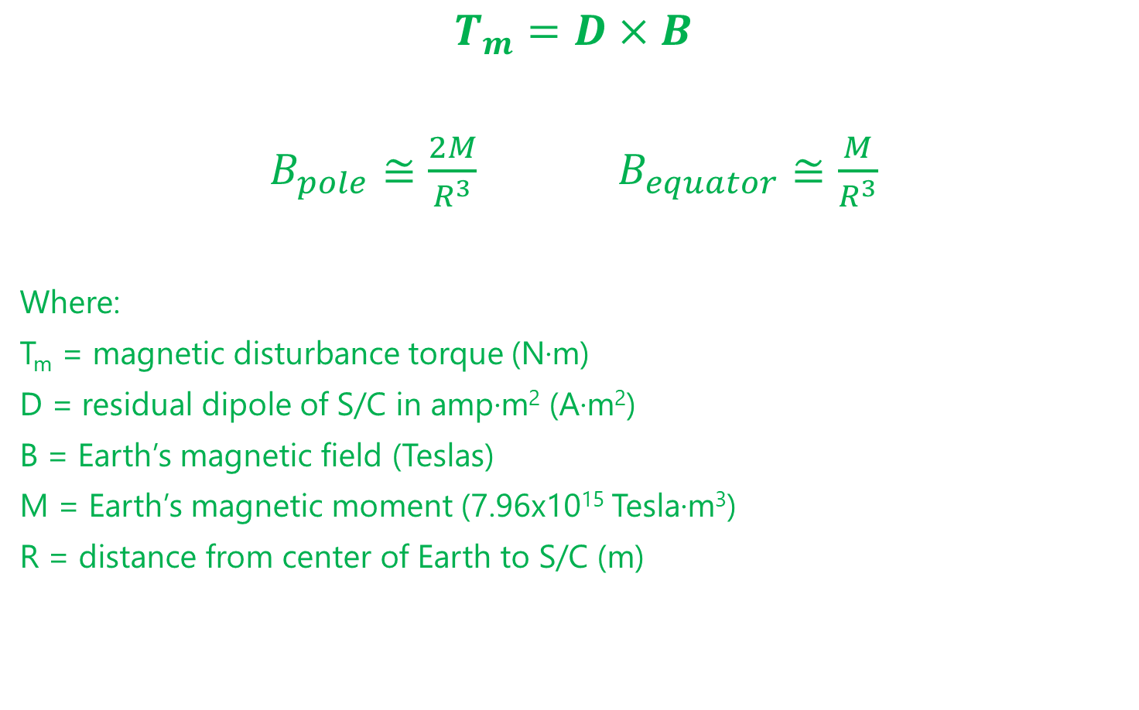
External Disturbance Torques – Magnetic
$$T_{m}=D×B$$
$B_{pole}≅\frac{2M}{R^{3}}$ $B_{equator}≅\frac{M}{R^{3}}$
Where:
T_{m} = magnetic disturbance torque (N·m)
D = residual dipole of S/C in amp∙m² (A∙m²)
B = Earth’s magnetic field (Teslas)
M = Earth’s magnetic moment (7.96x10¹⁵ Tesla∙m³)
R = distance from center of Earth to S/C (m)
For a single layer coil electromagnet:
D = NIAcoil
N = number of wire turns (loops)
I = current in wire (A)
Acoil = area of each loop (m^2)

Slide 19
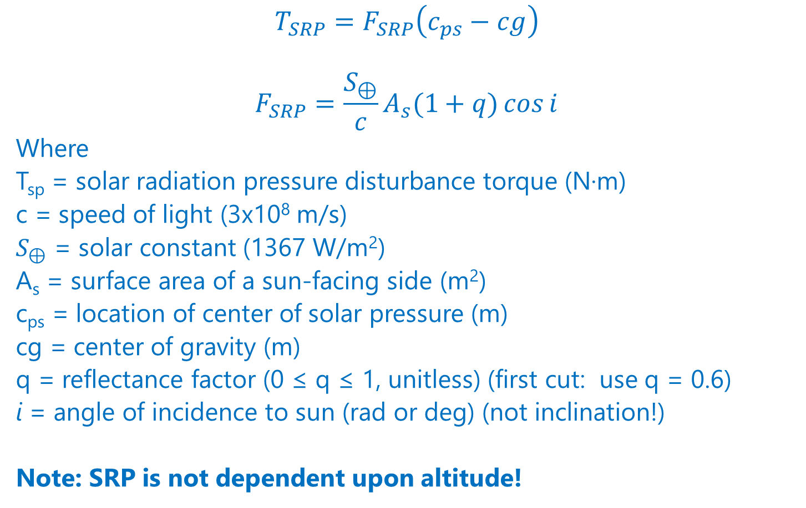
External Disturbance Torques – Solar Radiation Pressure (SRP)
$$T_{SRP}=F_{SRP}\left(c_{ps}−cg\right)$$
$$F_{SRP}=\frac{S_{⊕}}{c}A_{s}(1+q)\cos{i}$$
Where
T_{sp} = solar radiation pressure disturbance torque (N·m)
c = speed of light (3x10⁸ m/s)
$S_{⊕}$ = solar constant (1367 W/m²)
A_{s} = surface area of a sun-facing side (m²)
c_{ps} = location of center of solar pressure (m)
cg = center of gravity (m)
q = reflectance factor (0 ≤ q ≤ 1, unitless) (first cut: use q = 0.6)
i = angle of incidence to sun (rad or deg) (not inclination!)
Note: SRP is not dependent upon altitude!

Slide 20
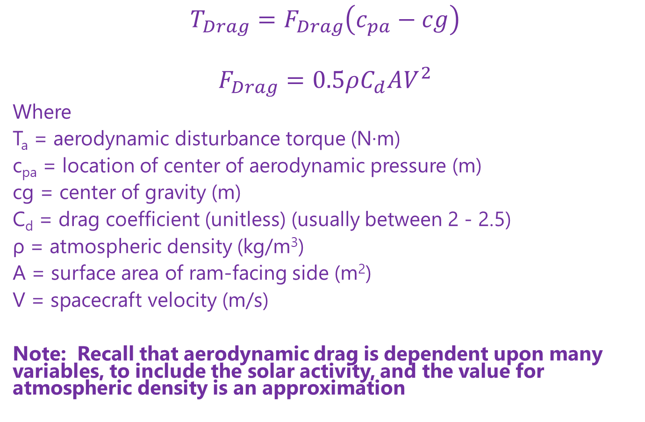
External Disturbance Torques – Drag
$$T_{Drag}=F_{Drag}\left(c_{pa}−cg\right)$$
$$F_{Drag}=0.5ρC_{d}AV^{2}$$
Where
T_{a} = aerodynamic disturbance torque (N·m)
c_{pa} = location of center of aerodynamic pressure (m)
cg = center of gravity (m)
C_{d} = drag coefficient (unitless) (usually between 2 - 2.5)
ρ = atmospheric density (kg/m³)
A = surface area of ram-facing side (m²)
V = spacecraft velocity (m/s)
Note: Recall that aerodynamic drag is dependent upon many variables, to include the solar activity, and the value for atmospheric density is an approximation

Slide 21
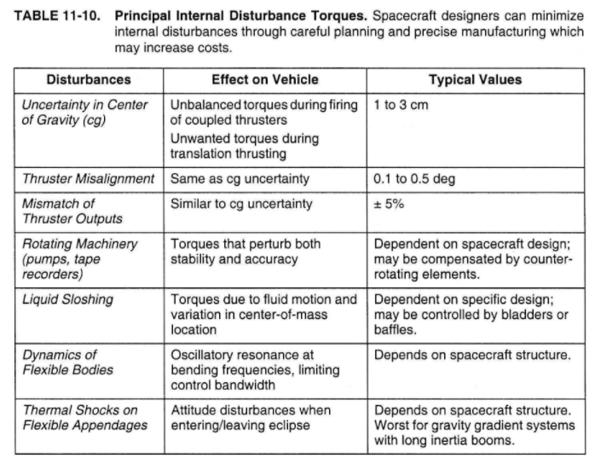
Other Disturbance Torques
Notes:
Spacecraft factors may cause unwanted disturbance torques. The following torques are internal torques—they don’t reject torque to the outside world. They will reduce pointing accuracy, but they will generally not build up significant momentum before averaging to zero.
- propellant sloshing
- rotational motors and pumps
- rotating solar arrays
- steered antennas
- appendage flexing (can be due to thermal expansion at eclipse edge)
The following items create unintentional external torques.
- thruster misalignment
- mismatched thruster pairs (including stuck thrusters)
- center of mass uncertainty
- residual magnetism and/or current loops

Slide 22
Reaction Wheels

Slide 23
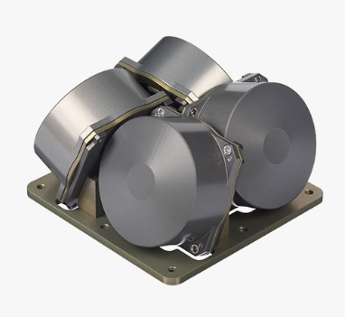
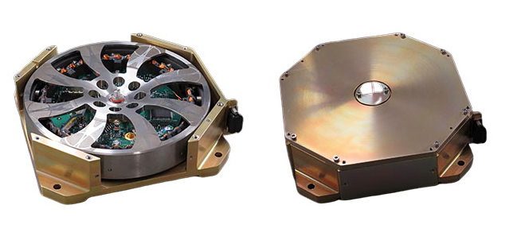
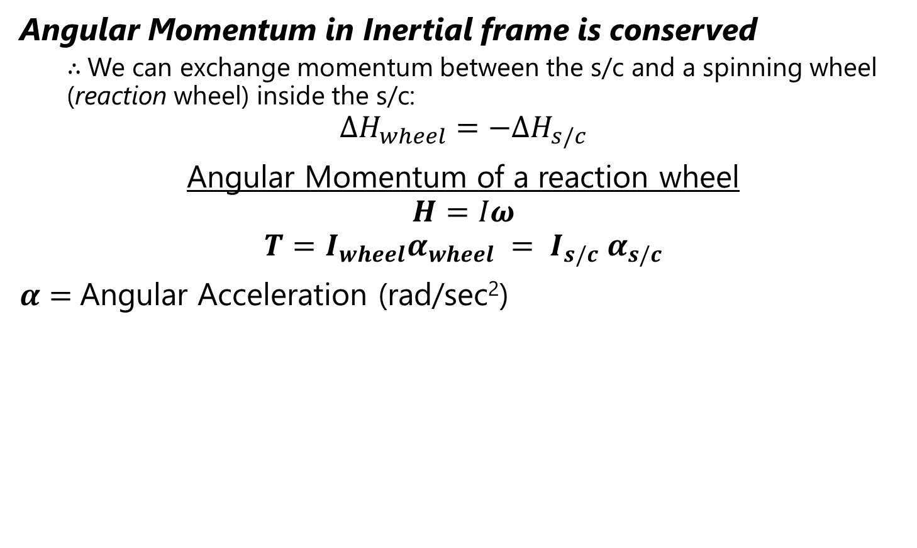
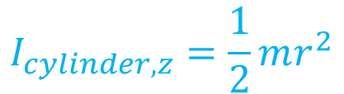
Reaction Wheels
Angular Momentum in Inertial frame is conserved
$∴$We can exchange momentum between the s/c and a spinning wheel (reaction wheel) inside the s/c:
$$ΔH_{wheel}=−ΔH_{s/c}$$
Angular Momentum of a reaction wheel
$$H=Iω$$
$$T=I_{wheel}α_{wheel} = I_{s/c} α_{s/c}$$
$α=$Angular Acceleration (rad/sec²)
$$I_{cylinder,z}=\frac{1}{2}mr^{2}$$
Notes:
A 3-axis stabilized spacecraft needs at least 3 reaction wheels to control pointing in 3 dimensions. Spacecraft often use 4 reaction wheels so they can maintain full attitude authority even if one wheel fails.

Slide 24
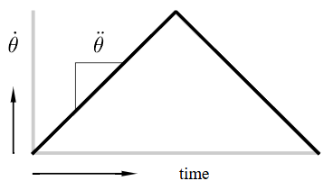
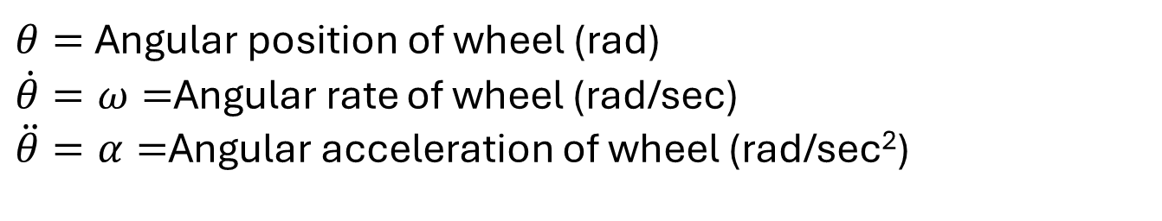
Slew Rate Example
$θ=$Angular position of wheel (rad)
$\dot{θ}=ω=$Angular rate of wheel (rad/sec)
$\ddot{θ}=α=$Angular acceleration of wheel (rad/sec²)

Slide 25
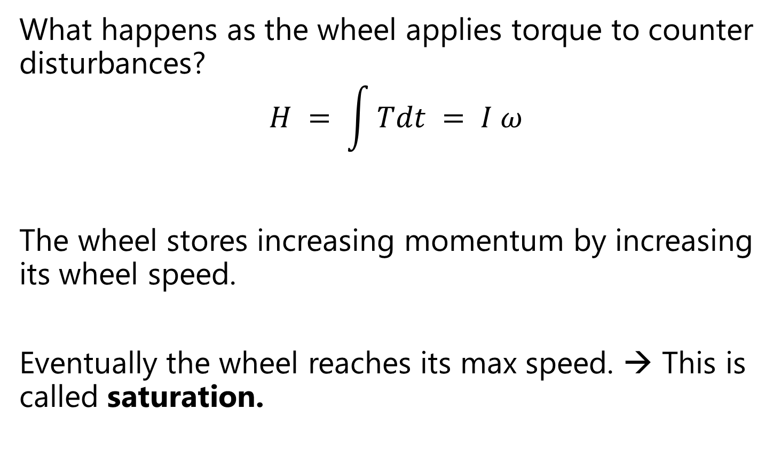
Saturation
What happens as the wheel applies torque to counter disturbances?
$$H = \int{Tdt} = I ω$$
The wheel stores increasing momentum by increasing its wheel speed.
Eventually the wheel reaches its max speed. → This is called saturation.

Slide 26
Desaturation
Reaction wheels are an internal attitude actuator that counter disturbance torques.
When the wheel reaches its maximum speed, it is said to be saturated and can no longer counter disturbance torques.
To maintain control of the spacecraft, the spacecraft needs to perform momentum dumping.
→Using an external actuator to reject momentum from the system.
Two common external attitude actuators that work in space:
Thrusters
Magnetorquers
Notes:
So far, we have countered external torques with a reaction wheel, which is an internal attitude actuator. When the wheel reaches its maximum speed, it is said to be saturated and can no longer counter disturbance torques.
To maintain control of the spacecraft, the spacecraft needs to perform *momentum dumping*—using an external actuator to reject momentum from the system. There are two common external attitude actuators that work in space.
In practice, spacecraft attitude is controlled with reaction wheels. When a wheel becomes saturated, an external actuator is activated to reject momentum from the system. As external actuator operates for a length of time, the wheel speed will gradually slow. The external actuator is turned off when the wheel reaches a predetermined neutral speed (perhaps zero).
Sometimes a spacecraft is tumbling immediately after deployment or after emerging from a fault condition. It may be tumbling so quickly that the reaction wheels cannot completely eliminate rotation. In this situation, the external actuator must be used to stabilize the spacecraft.
Changing momentum with thrusters is usually straightforward—fire the thruster(s) pointing in the direction opposite the spacecraft’s rotation.
If the spacecraft is tumbling, changing momentum with torque rods requires periodic switching of the torque rods to keep the spacecraft’s magnetic dipole correctly aligned with the Earth’s magnetic field (which can also change during the course of an orbit).

Slide 27
Desaturation (2)
When a wheel becomes saturated, an external actuator is activated to reject momentum from the system.
As the external actuator operates for a length of time, the wheel speed will gradually slow.
The external actuator is turned off when the wheel reaches a predetermined neutral speed (perhaps zero).
Notes:
Sometimes a spacecraft is tumbling immediately after deployment or after emerging from a fault condition. It may be tumbling so quickly that the reaction wheels cannot completely eliminate rotation. In this situation, the external actuator must be used to stabilize the spacecraft.
Changing momentum with thrusters is usually straightforward—fire the thruster(s) pointing in the direction opposite the spacecraft’s rotation.
If the spacecraft is tumbling, changing momentum with torque rods requires periodic switching of the torque rods to keep the spacecraft’s magnetic dipole correctly aligned with the Earth’s magnetic field (which can also change during the course of an orbit).

Slide 28
ADCS Sizing

Slide 29
ADCS Sizing Requirements
Maximum Torque Requirement
→ ADCS must be able to counteract disturbance torques
Momentum Storage Requirement
→ ADCS must be able to store enough momentum to absorb momentum from disturbances
Slew Maneuver Capability
→ADCS must meet slew rate requirements
Slew = turning the spacecraft
Notes:
Key Sizing Parameters
Maximum Torque Requirement
Determines how much control authority is needed for maneuvers.
Based on:
Required slew rate (how fast the spacecraft must turn).
Disturbance torques (gravity gradient, magnetic, solar pressure, drag).
Equation (simplified):
$$T_{req}≥I⋅α+T_{dist}$$
where $I$= inertia about axis, $α$= required angular acceleration, $T_{dist}$= disturbance torque.
Momentum Storage Requirement
Reaction wheels absorb angular momentum from disturbances.
They must not saturate too quickly between momentum dumps (via magnetic torquers or thrusters).
Equation (simplified):
$$H_{req}≥T_{dist}⋅Δt$$
where $Δt$= maximum time between desaturation events.
Slew Maneuver Capability
For pointing changes (e.g., moving telescope from one target to another).
Momentum storage must handle the slew angular momentum in addition to disturbances.

Slide 30

Countering Disturbances
Control authority: torque capability of actuators
Goal: want control authority to be greater than disturbance torques
For any single axis, disturbance torque may have cyclic terms (that integrate to zero over an integral # of cycles) and secular terms (not periodic)
Wheels can be sized counteract cyclic torques terms but will eventually saturate from secular terms

Slide 31
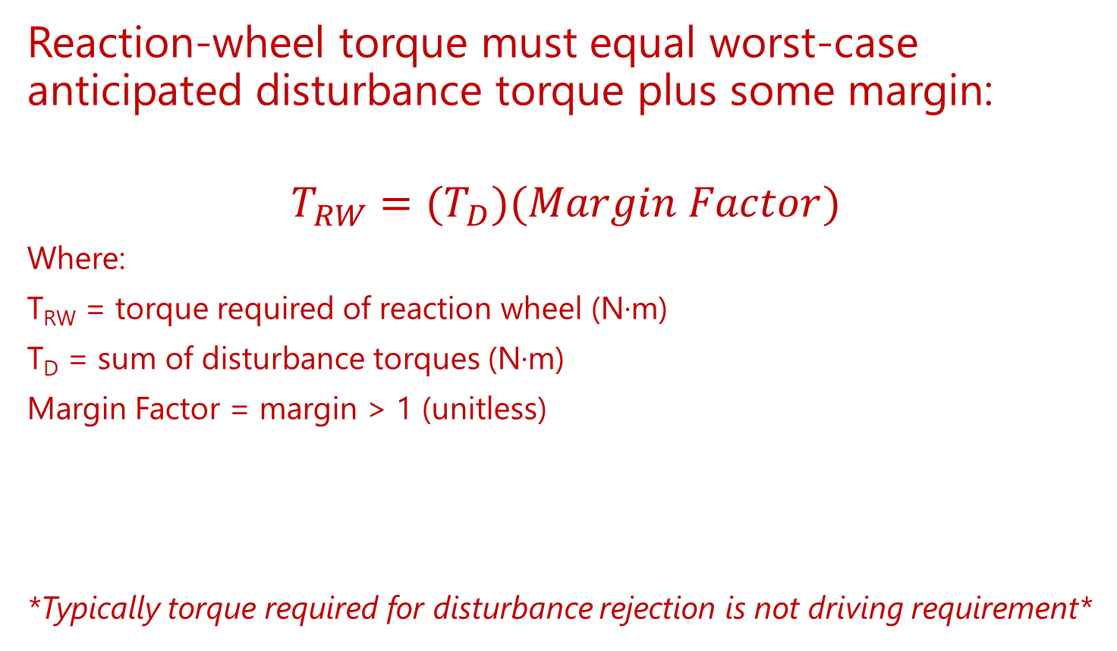
Reaction Wheel Sizing – Countering Disturbance Torques
Reaction-wheel torque must equal worst-case anticipated disturbance torque plus some margin:
$$T_{RW}=(T_{D})(Margin Factor)$$
Where:
T_{RW} = torque required of reaction wheel (N·m)
T_{D} = sum of disturbance torques (N·m)
Margin Factor = margin > 1 (unitless)
*Typically torque required for disturbance rejection is not driving requirement*

Slide 32
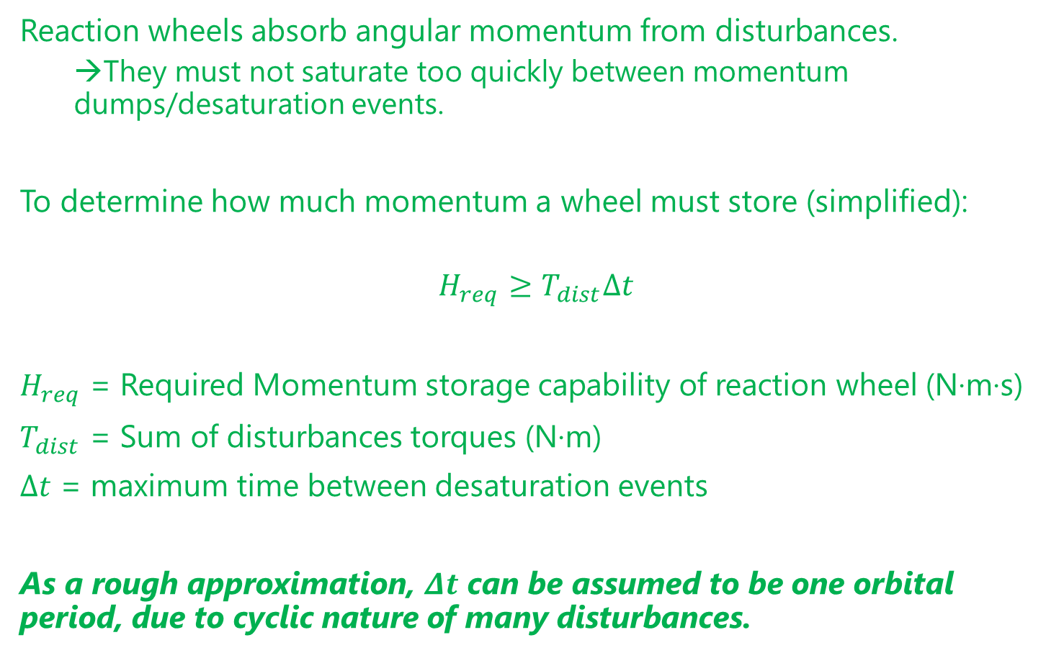
Reaction Wheel Sizing – Momentum Storage
Reaction wheels absorb angular momentum from disturbances.
→They must not saturate too quickly between momentum dumps/desaturation events.
To determine how much momentum a wheel must store (simplified):
$$H_{req}≥T_{dist}Δt$$
$H_{req}$ = Required Momentum storage capability of reaction wheel (N·m·s)
$T_{dist}$ = Sum of disturbances torques (N·m)
$Δt$ = maximum time between desaturation events
As a rough approximation, $Δt$ can be assumed to be one orbital period, due to cyclic nature of many disturbances.

Slide 33
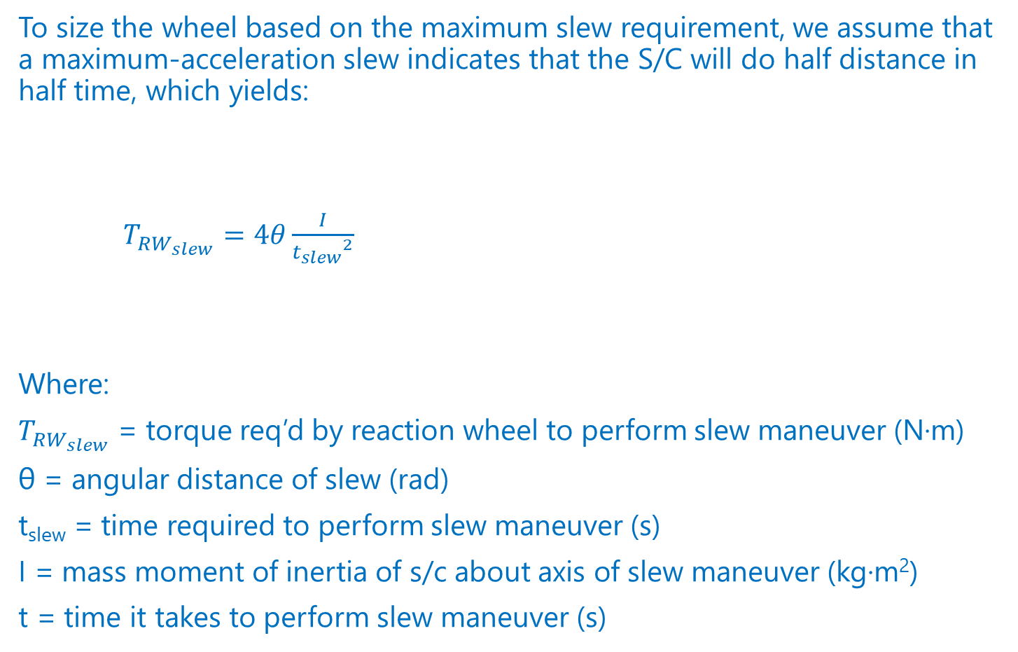
Reaction Wheel Sizing – Slew Maneuver Capability
To size the wheel based on the maximum slew requirement, we assume that a maximum-acceleration slew indicates that the S/C will do half distance in half time, which yields:
$T_{{RW}_{slew}}=4θ\frac{I}{{t_{slew}}^{2}}$
Where:
$T_{{RW}_{slew}}$ = torque req’d by reaction wheel to perform slew maneuver (N·m)
θ = angular distance of slew (rad)
t_{slew} = time required to perform slew maneuver (s)
I = mass moment of inertia of s/c about axis of slew maneuver (kg·m²)
t = time it takes to perform slew maneuver (s)

Slide 34

Thruster Sizing (1/3)
To size thrusters to counter external disturbances:
$$F_{t}=\frac{T_{D}}{L}$$
Where
F_{t} = force required by thruster (N)
T_{D} = sum of disturbance torques (N·m)
L = thruster’s moment arm (m)

Slide 35
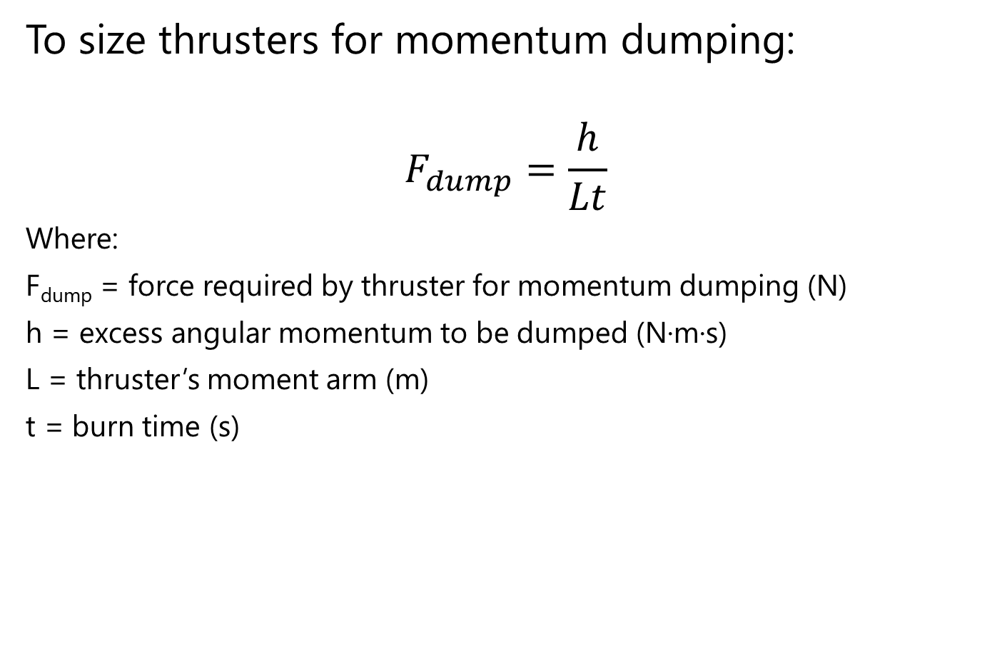
Thruster Sizing (2/3)
To size thrusters for momentum dumping:
$$F_{dump}=\frac{h}{Lt}$$
Where:
F_{dump} = force required by thruster for momentum dumping (N)
h = excess angular momentum to be dumped (N·m·s)
L = thruster’s moment arm (m)
t = burn time (s)

Slide 36
ADCS Sizing Summary
Reaction wheel sizing
Reaction wheel torque > disturbance torques
Wheel stores sufficient momentum (at least one orbit’s worth)
Torque meets slew rate requirement
External actuator sizing
Actuator torque > disturbance torques (generally a trivial requirement)

Slide 37
Example
Given:
S/C mass = 174 kg
I_{x} = I_{z} = 75 kg∙m²
I_{y} = 45 kg∙m²
S/C cross-sectional area, A_{s} = 2 m²
coefficient of drag, C_{d} = 2.5
atmospheric density at 700 km altitude: ρ = 1.47x10⁻¹³ kg/m³
Maximum deviation from nadir-pointing = 30 deg
(c_{pa} – c_{m}) = 0.3 m
(c_{ps} – c_{m}) = 0.3 m
coefficient of reflectivity, q = 0.6
S/C magnetic dipole, D = 1 A∙m²
pointing accuracy required < 0.1 deg
slew maneuver of 30 deg in no more than 10 minutes
Find: Size reaction wheels (find required torque and angular momentum storage)

Slide 38
Solution
Approach: Look at all of the limitations discussed and see which requires the most momentum storage
Torque Capability (N·m)
Disturbance rejection
Slew maneuver
Momentum Storage Capacity (N·m·s)
Disturbance rejection over an orbit
Slew maneuver

Slide 39
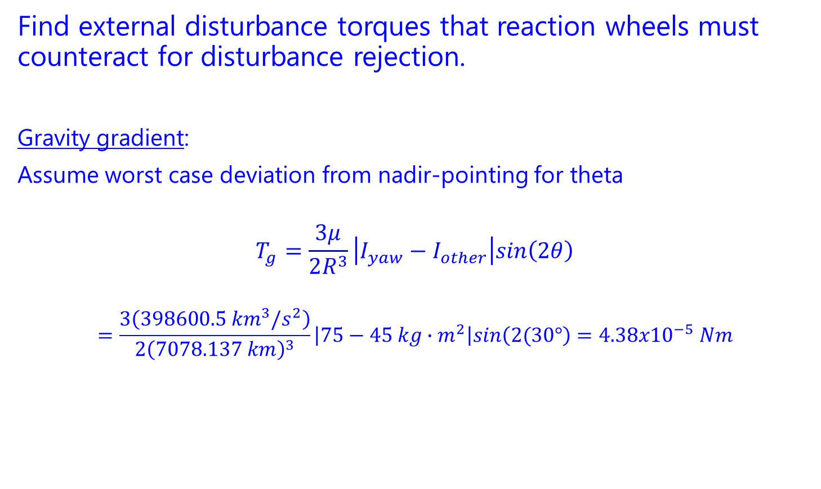
Solution
Find external disturbance torques that reaction wheels must counteract for disturbance rejection.
Gravity gradient:
Assume worst case deviation from nadir-pointing for theta
$$T_{g}=\frac{3μ}{2R^{3}}\left|I_{yaw}−I_{other}\right|sin\left(2θ\right)$$
$$=\frac{3\left(398600.5 {km}^{3}/s^{2}\right)}{2{\left(7078.137 km\right)}^{3}}\left|75−45 kg∙m^{2}\right|sin\left(2(30°\right)=4.38x{10}^{−5} Nm$$

Slide 40
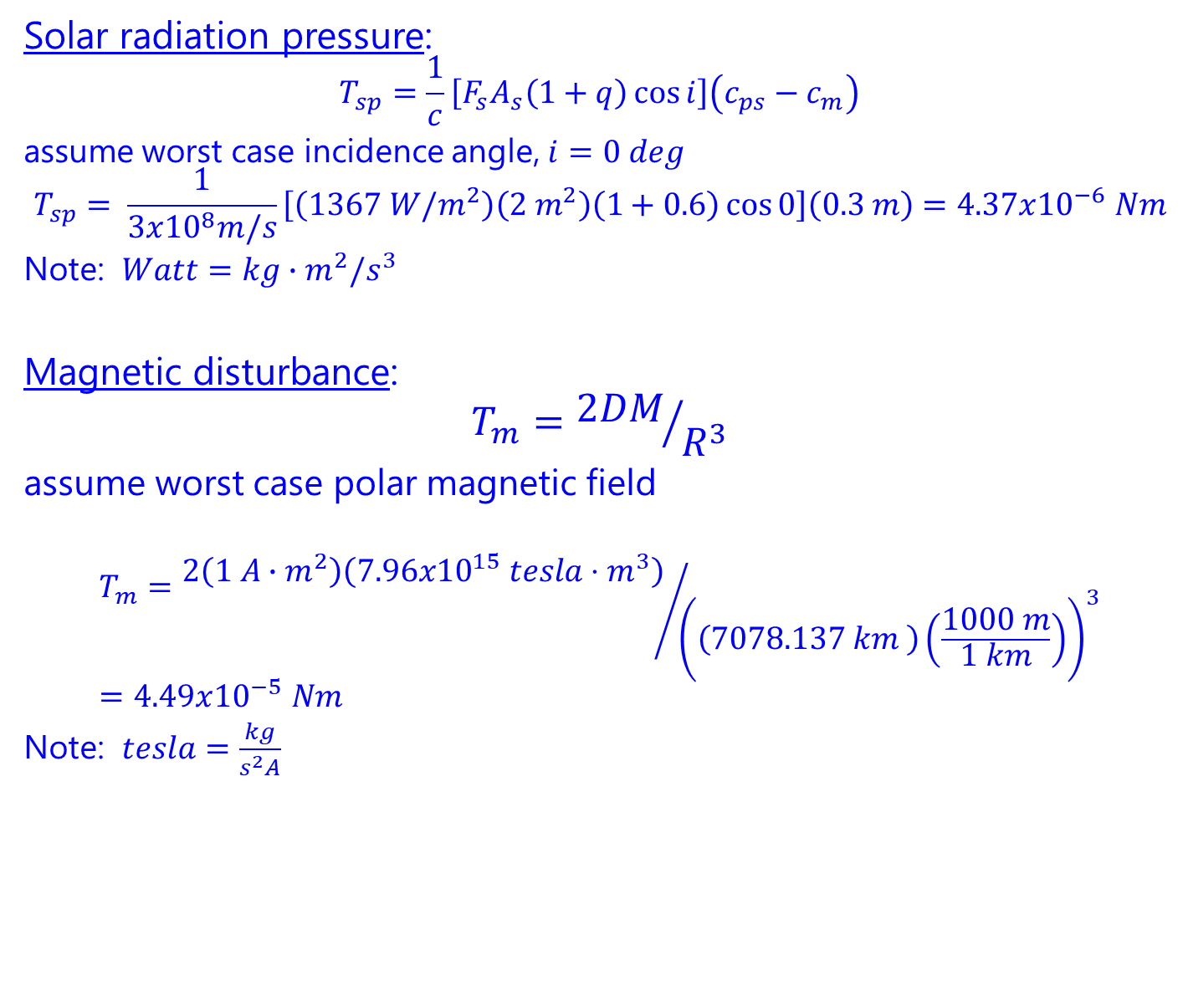
Solution
Solar radiation pressure:
$$T_{sp}=\frac{1}{c}\left[F_{s}A_{s}\left(1+q\right)\cos{i}\right]\left(c_{ps}−c_{m}\right)$$
assume worst case incidence angle, $i=0 deg$
$$T_{sp}= \frac{1}{3x{10}^{8}m/s}\left[\left(1367 W/m^{2}\right)\left(2 m^{2}\right)\left(1+0.6\right)\cos{0}\right]\left(0.3 m\right)=4.37x{10}^{−6} Nm$$
Note: $Watt=kg∙m^{2}/s^{3}$
Magnetic disturbance:
$$T_{m}={2DM}/{R^{3}}$$
assume worst case polar magnetic field
$$T_{m}={2\left(1 A∙m^{2}\right)\left(7.96x{10}^{15} tesla⋅m^{3}\right)}/{{\left(\left(7078.137 km \right)\left(\frac{1000 m}{1 km}\right)\right)}^{3}}=4.49x{10}^{−5} Nm$$
Note: $tesla=\frac{kg}{s^{2}A}$

Slide 41
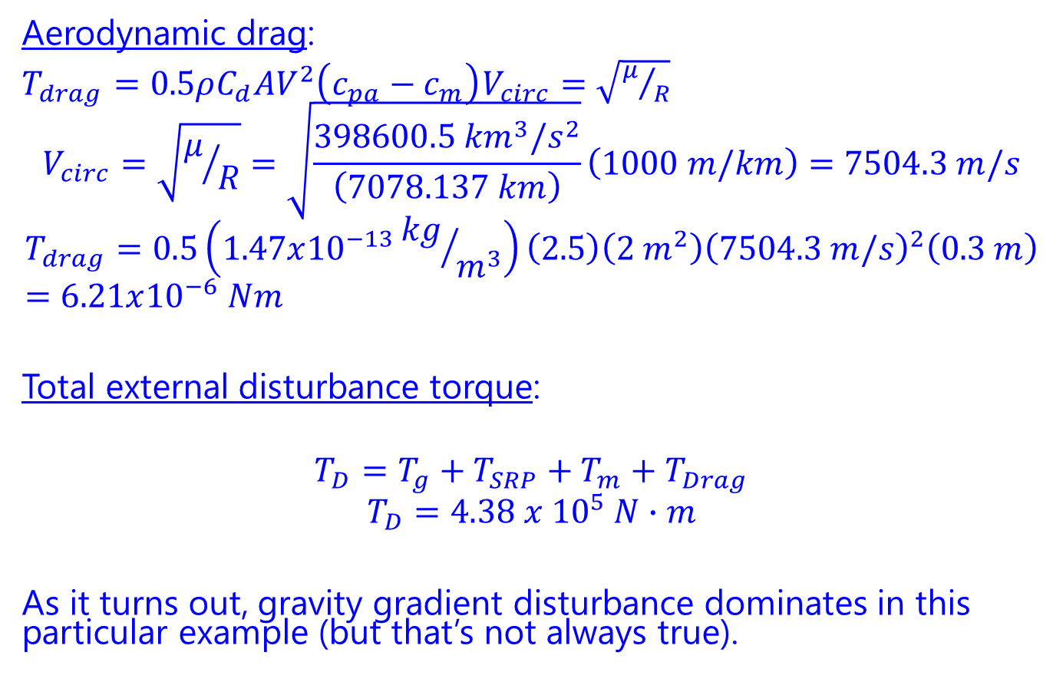
Solution
Aerodynamic drag:
$T_{drag}=0.5ρC_{d}AV^{2}\left(c_{pa}−c_{m}\right)$ $V_{circ}=\sqrt{μ/R}$
$$V_{circ}=\sqrt{μ/R}=\sqrt{\frac{398600.5 {km}^{3}/s^{2}}{\left(7078.137 km\right)}}\left(1000 m/km\right)=7504.3 m/s$$
$$T_{drag}=0.5\left(1.47x{10}^{−13}{kg}/{m^{3}}\right)\left(2.5\right)\left(2 m^{2}\right){\left(7504.3 m/s\right)}^{2}\left(0.3 m\right)=6.21x{10}^{−6} Nm$$
Total external disturbance torque:
$$T_{D}=T_{g}+T_{SRP}+T_{m}+T_{Drag}$$
$$T_{D}=4.38 x {10}^{5} N∙m$$
As it turns out, gravity gradient disturbance dominates in this particular example (but that’s not always true).

Slide 42
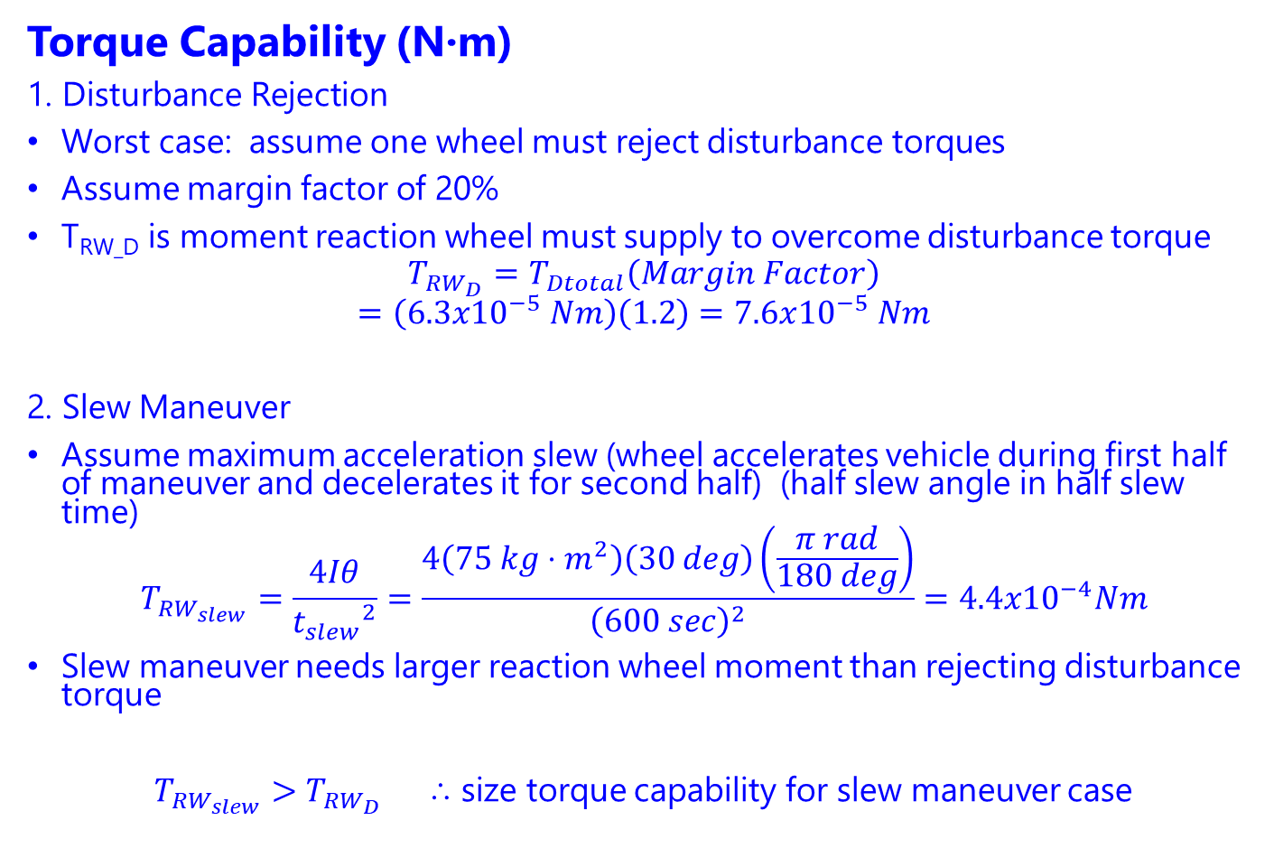
Solution
Torque Capability (N·m)
1. Disturbance Rejection
Worst case: assume one wheel must reject disturbance torques
Assume margin factor of 20%
T_{RW_D} is moment reaction wheel must supply to overcome disturbance torque
$$T_{RW_{D}}=T_{Dtotal}\left(Margin Factor\right)$$
$$=\left(6.3x{10}^{−5} Nm\right)\left(1.2\right)=7.6x{10}^{−5} Nm$$
2. Slew Maneuver
Assume maximum acceleration slew (wheel accelerates vehicle during first half of maneuver and decelerates it for second half) (half slew angle in half slew time)
$$T_{RW_{slew}}=\frac{4Iθ}{{t_{slew}}^{2}}=\frac{4\left(75 kg⋅m^{2}\right)\left(30 deg\right)\left(\frac{π rad}{180 deg}\right)}{{\left(600 sec\right)}^{2}}=4.4x{10}^{−4}Nm$$
Slew maneuver needs larger reaction wheel moment than rejecting disturbance torque
$T_{RW_{slew}}>T_{RW_{D}}$ ⸫ size torque capability for slew maneuver case

Slide 43
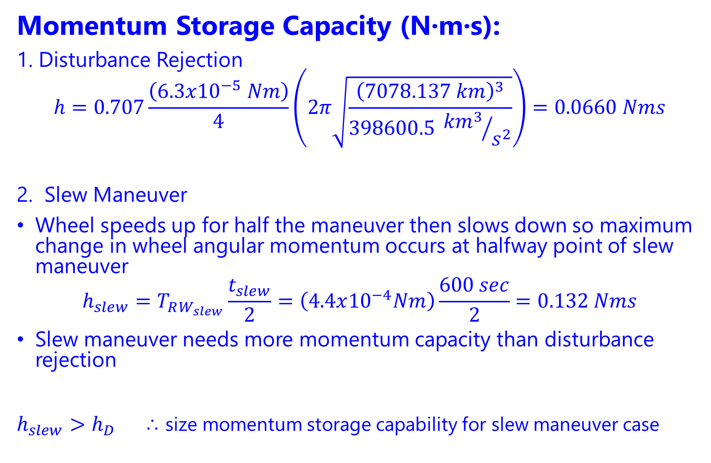
Solution
Momentum Storage Capacity (N·m·s):
1. Disturbance Rejection
$$h=0.707\frac{\left(6.3x{10}^{−5} Nm\right)}{4}\left(2π\sqrt{\frac{{\left(7078.137 km\right)}^{3}}{398600.5 {{km}^{3}}/{s^{2}}}}\right)=0.0660 Nms$$
2. Slew Maneuver
Wheel speeds up for half the maneuver then slows down so maximum change in wheel angular momentum occurs at halfway point of slew maneuver
$$h_{slew}=T_{RW_{slew}}\frac{t_{slew}}{2}=\left(4.4x{10}^{−4}Nm\right)\frac{600 sec}{2}=0.132 Nms$$
Slew maneuver needs more momentum capacity than disturbance rejection
$h_{slew}>h_{D}$ ⸫ size momentum storage capability for slew maneuver case

Slide 44

Solution
Final answer:
Reaction wheels must have at least
$4.4x{10}^{−4}Nm$ of torque capability
$0.132 Nms$ of angular momentum storage

Slide 45
Extra Topics

Slide 46
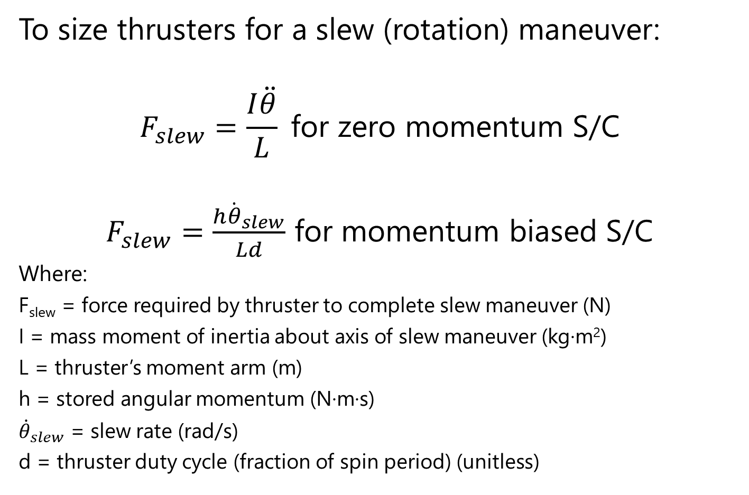
Thruster Sizing (3/3)
To size thrusters for a slew (rotation) maneuver:
$$F_{slew}=\frac{I\ddot{θ}}{L} \text{for} \text{zero} \text{momentum} \text{S}\text{/}\text{C}$$
$F_{slew}=\frac{h{\dot{θ}}_{slew}}{Ld}$ for momentum biased S/C
Where:
F_{slew} = force required by thruster to complete slew maneuver (N)
I = mass moment of inertia about axis of slew maneuver (kg·m²)
L = thruster’s moment arm (m)
h = stored angular momentum (N·m·s)
${\dot{θ}}_{slew}$ = slew rate (rad/s)
d = thruster duty cycle (fraction of spin period) (unitless)

